Slide 1

D365 F&O OData From Zero to Hero

Slide 2
Synopsis
Want to know everything about OData? We'll talk about how, when, where and why to use it and dive deep into high performance scenarios to support your custom integrations using OData. We’ll discuss authentication, client generation using Connected Services, basic CRUD operations, performance considerations and how to handle 429 error codes.
PowerPoint available for download at https://github.com/NathanClouseAX/CommunityPresentations/tree/master/2021

Slide 3

Free Stuff
Gift Card Give Away!

Slide 4

Nathan Clouse
Technical Architect enVista Corp.
Microsoft Business Applications MVP
nclouse@envistacorp.com
www.atomicax.com
@NathanClouseAX

Slide 5
Topics
Audience
Define Problems
Performance
Workloads
What is OData a good tool for?
CRUD
What is OData not a good tool for?
Everything else
Other considerations
OData Data entities
Read Performance
Data entity complexity
Multi-threading
EXPAND()?
Insert
Update
Delete
Notes:
What is odata? “RESTful api” REST is an acronym for REpresentational State Transfer and an architectural style for distributed hypermedia systems

Slide 6
Sources
https://github.com/NathanClouseAX/AAXDataEntityPerfTest
http://www.atomicax.com/content/odata-experiment-deep-dive-odata-and-how-use-it
https://github.com/NathanClouseAX/AAXDataEntities
https://github.com/users/NathanClouseAX/projects/2

Slide 7
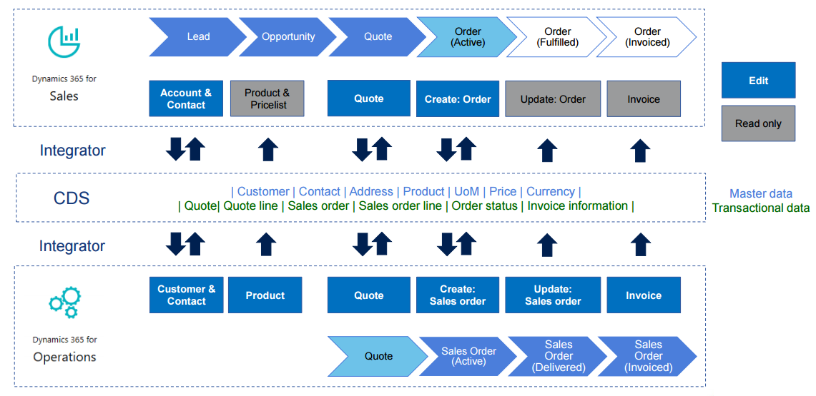
Performance
What is your required level of performance?
What is acceptable?
What is not?
Is this workload dependent?
What processes have specific SLAs?
Are those SLA’s known and declared?
Anything else that needs to be called out?
How are we going to use OData?

Slide 8

Workloads
Specialized workflow for a module to support the business?
Portal for customers or vendors to view data?
Workspace for vendors or customers to enter orders, update statuses, etc.
Notes:
Solid Snake – Metal Gear Solid

Slide 9

Primary Success Factors
Get x in less than y milliseconds?
Update x in less than y ms?
Insert x in less than y ms?
Delete x in less than y ms
But WHY?
Notes:
Ellie – Last of Us

Slide 10
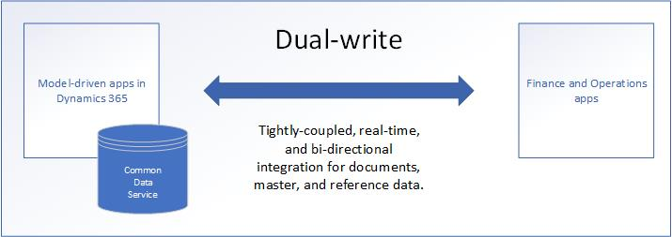
What about Dual-Write
Synchronous and bidirectional data flow between applications
Synchronization with online and offline/asynchronous modes.
Out-of-box setup experience for new customers
Ability to sync initial data between the applications
Dataverse

Slide 11

What is OData a good tool for?
CRUD operations on declared data entities
Includes customizations if new fields added to entities
Postings not generally supported such as posting a sales order invoice
Think “spreadsheet” or “List Management”
Used by the Excel Add-in

Slide 12
What is OData NOT a good tool for?
Data extraction in bulk
use the DMF with BYOD
export to data lake
Posting transactions
Use a custom service
OData can do it though*
Managing data using the Power Platform
Use Dual Write
Exporting/Importing data on a schedule
Use recurring integration framework
Use batch data framework
React to something happening or changing
Use Business Events
Use Power Automate
Use Azure Integration Tools

Slide 13

Other Considerations
In Development / T1, all parts of the app are in the same place (SQL, IIS, MR, Batch, everything else)
F&O
SQL

Slide 14
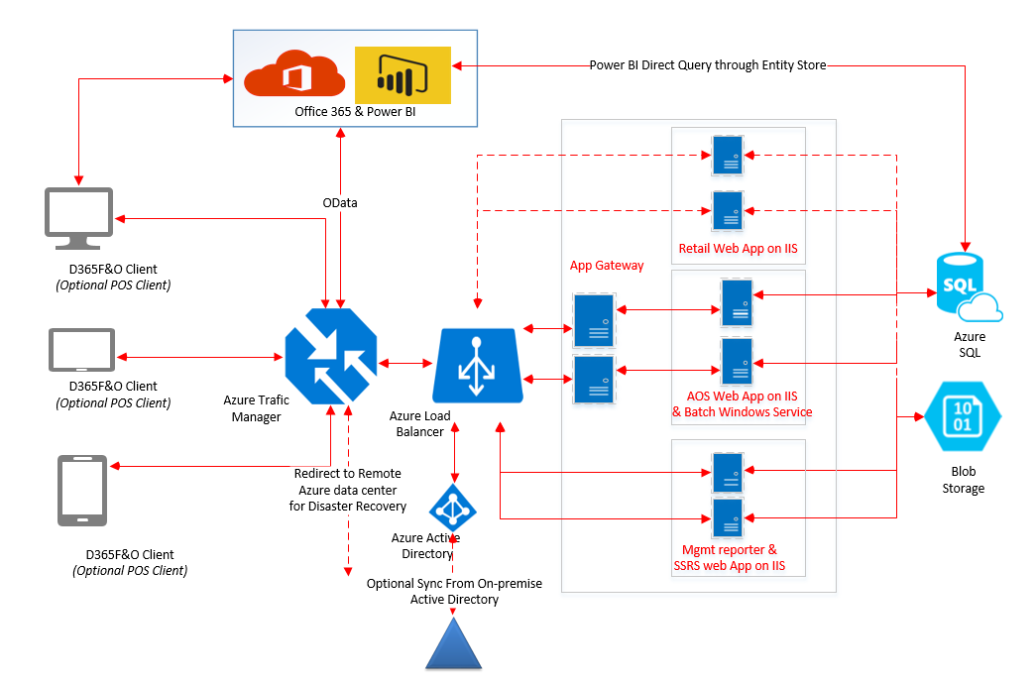
Other Considerations (cont.)
In UAT or greater / T2, all parts of the app could be or are known to be in different places, so network lag becomes a consideration

Slide 15
SQL
F&O

Slide 16
Other Considerations (cont.)
In UAT or greater / T2, all parts of the app could be or are known to be in different places, so network lag becomes a consideration

Slide 17
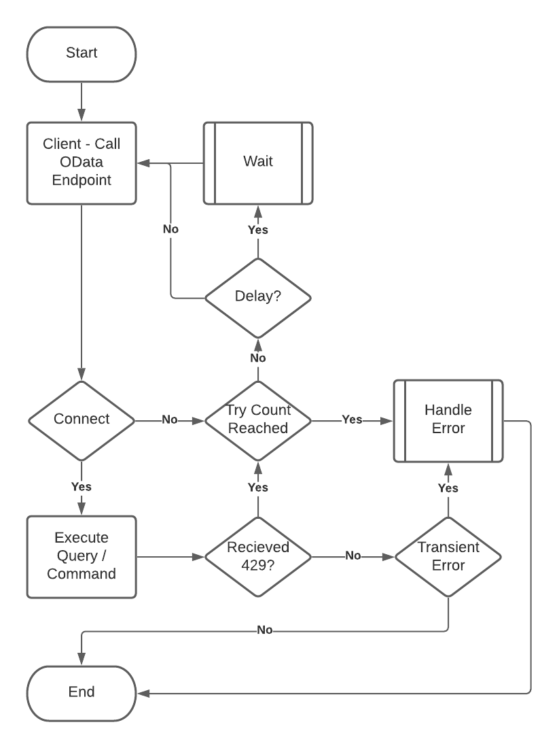
Other Considerations (cont.)
429 Status Code – “Please Wait”
Priority Based Throttling as of 10.0.19
For OData and custom service requests, an error which states "Too many requests" will be sent when system health and performance are affected.
You can query throttling events on the Lifecycle Services Monitoring page.

Slide 18

Data Entities Vs OData Data Entities
Little difference
Set “public” to yes
Very similar
OData enabled entities require a little more code
Optimized for OData usage
Enforce more business rules and logic
Tests should include DMF, x++ and C# (or similar) testing
Confirm all entry points give the same result

Slide 19

Read Performance
Biggest, most visible area for performance
(probably) the bulk of the workload for a given integration
Must scope before you can update or delete
Customer Portal: get list of orders, select one from a list, get the details for that order, review extended details (pick list, pack slip, invoice, etc)
Customer Workspace: User get’s a list of order, selects one from that list, gets details, makes changes, sends update

Slide 20

Read Performance – Data Entity Complexity
Fewer Columns = “faster”
Fewer table / joins = “faster”
ReadOnly attribute is for functionality, not performance
“faster” for 1 row means more faster for 10+ rows
Row vs Set behaves differently

Slide 21
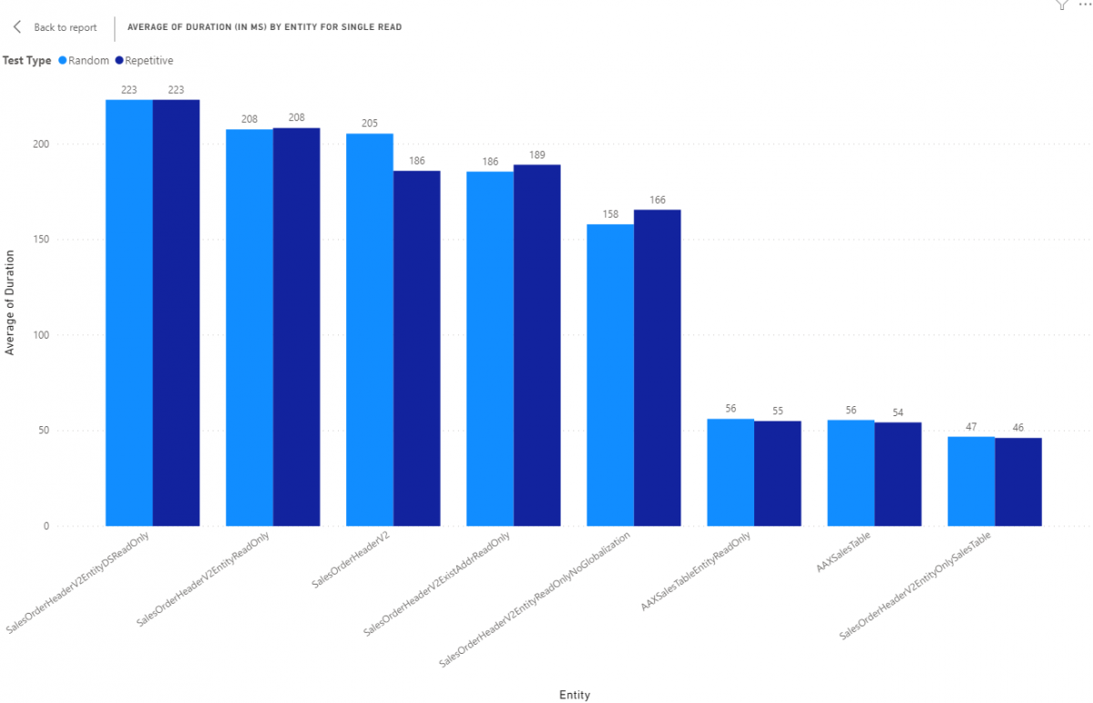
Notes:
Explain setup and tests, 100 random reads from data entities with different key characteristics to draw out beahviors
1 This is a copy of the standards entity with all data sources marked as being read only
2 This is a copy of the standard entity with the entire entity set to read only
3 OOTB entity
4 OOTB entity
5 This is a copy of the standard entity that is read only but also all data sources that were related to globalization have been removed such as SalesTable_W, SalesTable_BR, and BaseDocument_IT
6 This is an entity built on top of table SalesTable as a read only entity.
7 This is an entity built on top of table SalesTable only but it supports all CRUD operations but doesn't have any code in the entity
8 This is a copy of the standard entity with all data sources that weren't table SalesTable removed

Slide 22

Read Performance – Data Entity Complexity
No sub-selects is ideal
Data entity gets boiled down to be a SQL view
Views can contain sub-selects to other data sources
Can ( and will ) kill performance

Slide 23
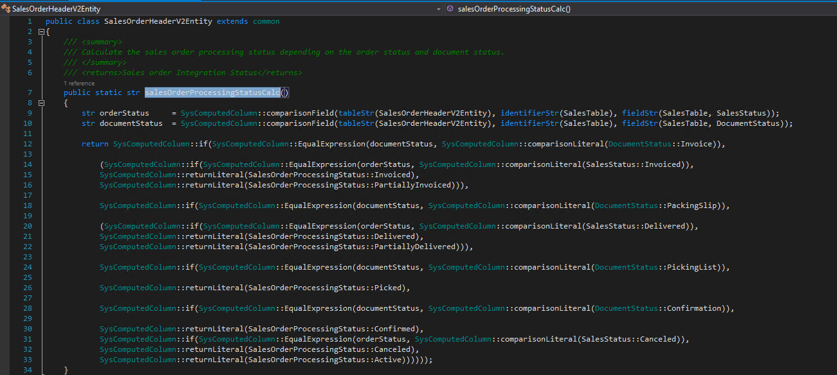

Slide 24
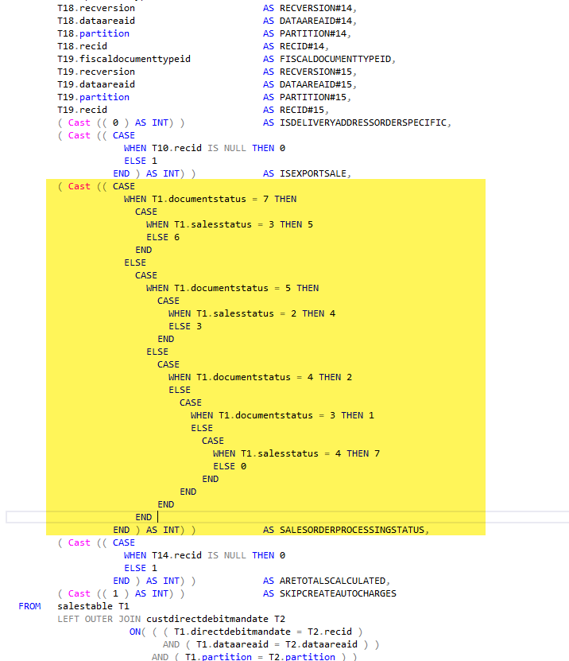

Slide 25
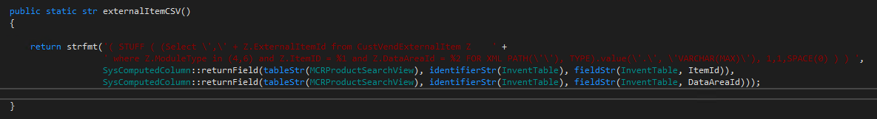
NO
Notes:
Correlated subqueries should be used sparingly (i.e. when an inner condition refers to an outer clause).

Slide 26
Notes:
Correlated subqueries should be used sparingly (i.e. when an inner condition refers to an outer clause).

Slide 27

Read Performance – Consumer Tricks
Using a SELECT() will provide some performance improvements when fetching more than 1 record
Using a SELECT() will provide some performance degradation when fetching just 1 record

Slide 28
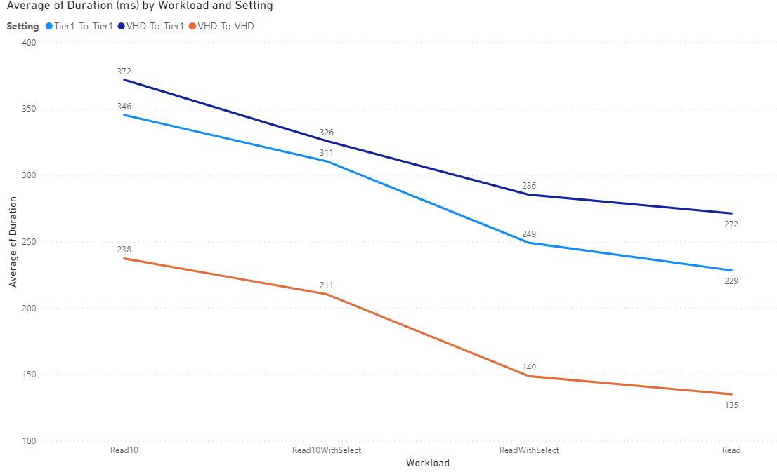
1
2
3
4
Notes:
Using SalesOrderHeaderV2 OOTB entity
1 reading 10 Sales Orders
2 reading 10 sales orders with a SELECT() on 5 fields – only getting 5 fields
3 Reading 1 record with SELECT() on 5 fields,
4 reading 1 record
Whats going on? SELECT() is an extra step, requires extra time
Net savings related to performance are related to having to package and send less to the requester
Also initial overhead for processing n records that is incurred regardless of what n is

Slide 29

Read Performance – Consumer Tricks, Part 2
Filter based on underlying data sources indexes
If a specific index isn't known, specify everything you can and let SQL pick an index for you
The better the index selection for a query, the faster the query is as well as being more reliable and predictable from a performance perspective

Slide 30
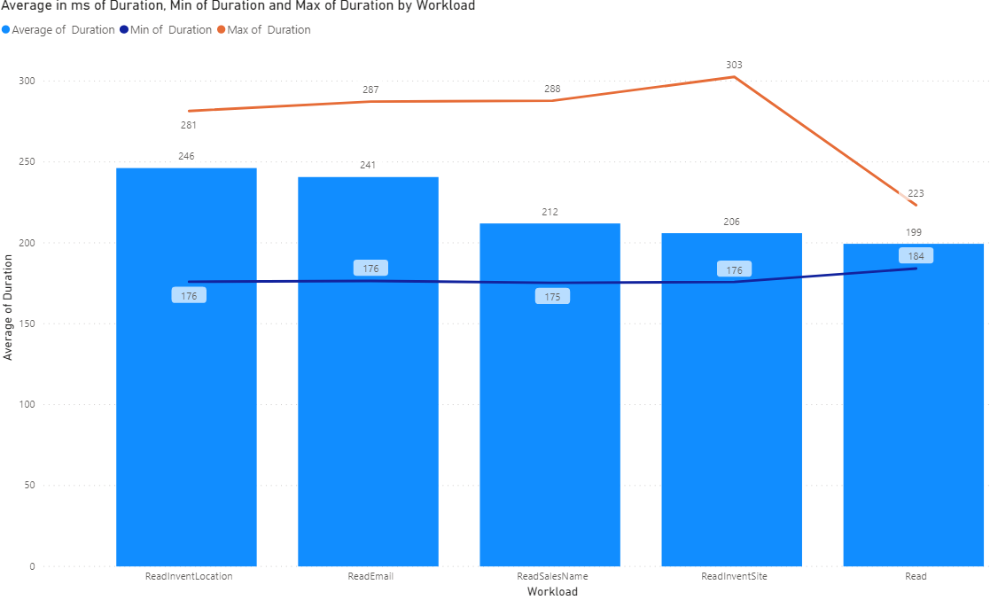
Notes:
Fetching 1 record by specific indexes on SalesOrderHeaderV2
Callout that sales order header v2 has range on SalesType = SalesOrder
No index on inventLocationId, email, salesname, or inventsite
Note that the best performing is just SalesId

Slide 31
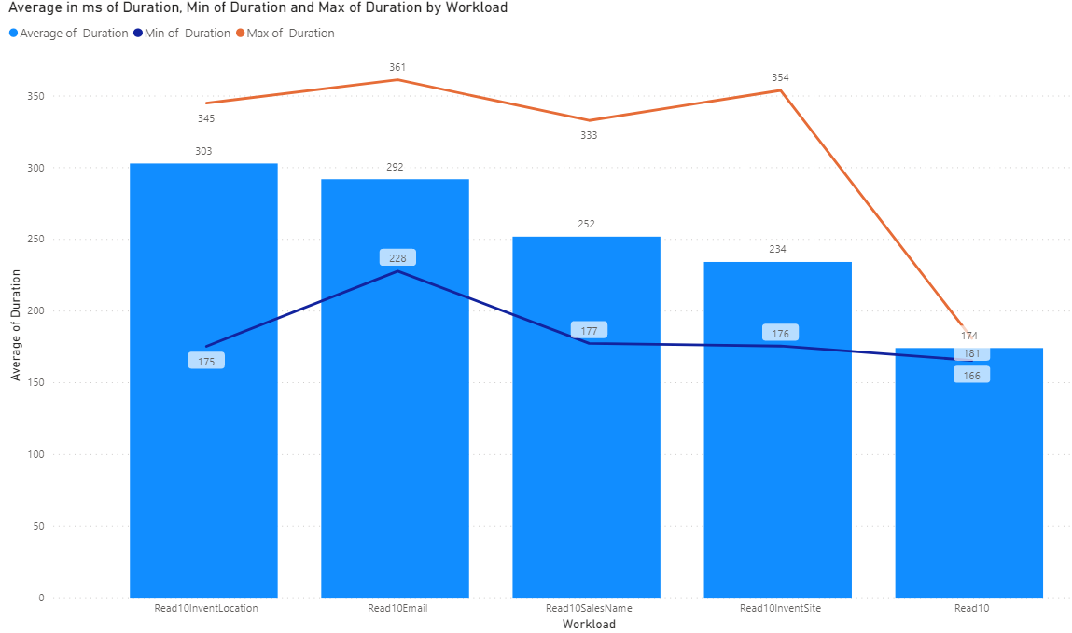
Notes:
Fetching 10 record by specific indexes on SalesOrderHeaderV2
Note that the best performing is just SalesId

Slide 32

Read Performance – Consumer Tricks Part 3
Limit use of ORDER BY statements
ORDER BY on a specific index
Calculated fields / Sub-selects are marginally more performant than "normal" fields not in an index
May be based on limited dataset from Contoso
Test for your data

Slide 33
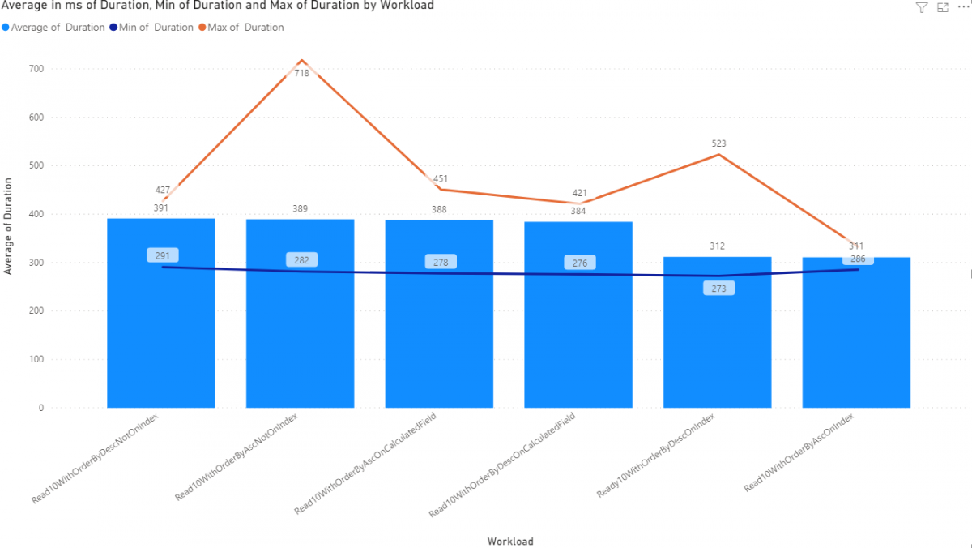
Notes:
Dev VM
Read 10 With Order By Descending Not on an Index - We're going to read 10 Sales Order Headers with an order by clause in the OData query with the order by descending specifically not being used on a field in an index
Read 10 with Order By Ascending Not on an Index - Same as the previous test but with an order by ascending
Read 10 with Order by Ascending On a calculated field - Same as the previous test but with an order by ascending
Read 10 with Order By Descending On a calculated field - We're going to read 10 Sales Order Headers with an order by clause in the OData query with an order by descending on a calculated field. Calculated fields are SQL Sub-selects in the view so they cannot be part of an index by definition
Read 10 With Order By Descending On an Index - We're going to read 10 Sales Order Headers with an order by clause in the OData query with an order by descending on a field specifically selected as being part of an index.
Read 10 With Order By Ascending on an Index - Same as the previous test but with an order by ascending

Slide 34

Adding More Threads, Breaking Stuff
More work means longer working times
Largely a CPU constrained throughput problem
More CPU means more speed
Request processing times scale linearly with thread count
Development, UAT and PROD could and/or will act differently
Don't do this

Slide 35
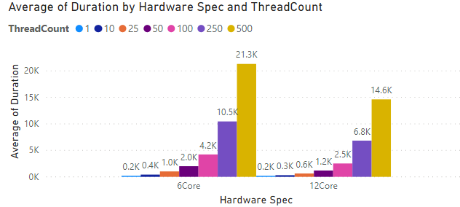

Slide 36
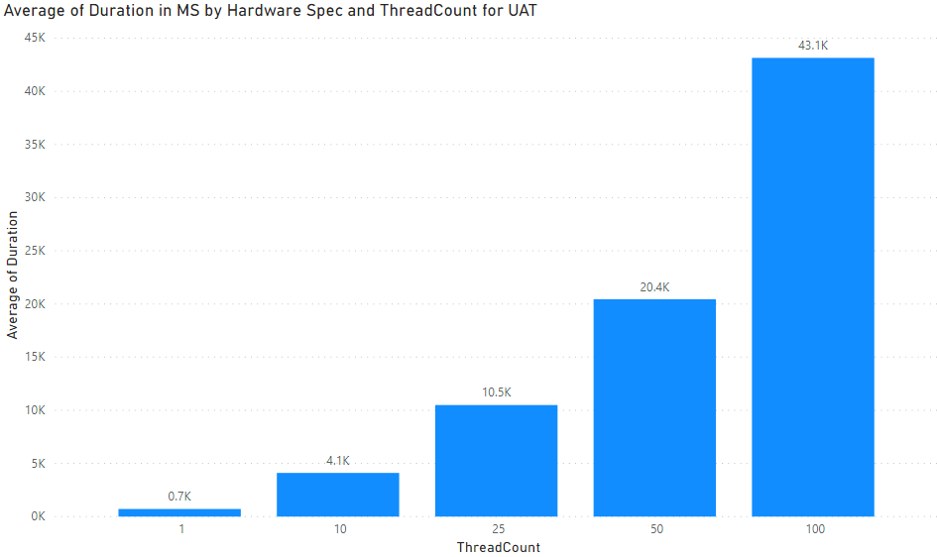
Notes:
UAT
250 and 500 thread count tests failed, started getting 500 errors from server
Throttled differently than dev so something to keep in mind

Slide 37

Read performance – EXPAND()
What is EXPAND()?
Slower on T1 compared to doing 2 requests
Faster T2+ compared to doing 2 requests

Slide 38
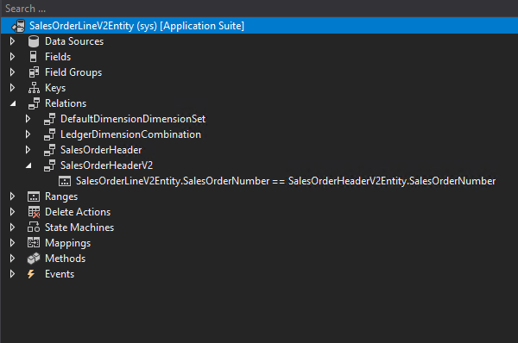

Slide 39
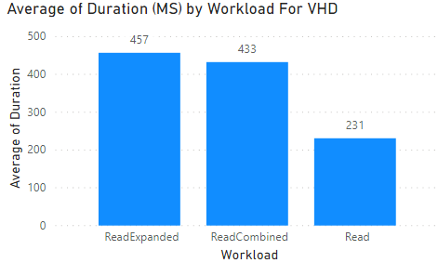
DEV
Notes:
Reading sales line, reading sales line with header expanded, reading line and header 2 different operations

Slide 40
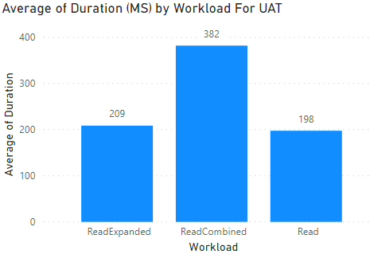
UAT

Slide 41

Pagination
What is pagination?
2 Methods
Skip and Take
Take x while skipping y
Take 10000, skip (offset)
Continuation
Each page has a link to the next
This follows that link

Slide 42
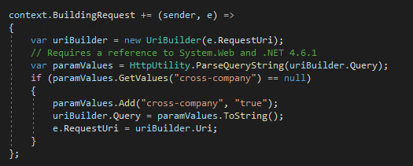
Cross Company
Get data from ALL legal entities
Authentication tied to user
User tied to company

Slide 43

Read Performance - Simplicity
May have to copy/paste OOTB entities and remove features for performance
“Chop Out” what you don’t need
Build your own based on needs
Must reconcile changes with each release
Complete control

Slide 44
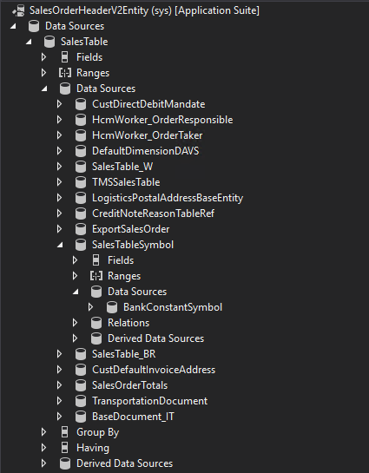
Notes:
Pink arrows are localizations
blue are entities or views that cause slowness
green is related to specific functionality that may not be used

Slide 45
Insert Performance – “Compound” Entities
Have lots of data sources
Lots of code
Performance scales to amount of data being persisted.
A few fields only is fast
Adding more fields increases time to persist
Saving data in many fields also increases time to persist

Slide 46
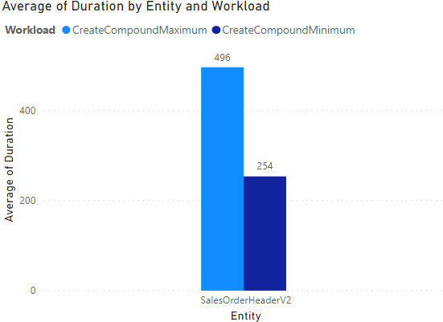
Development / T1
Notes:
DEV

Slide 47
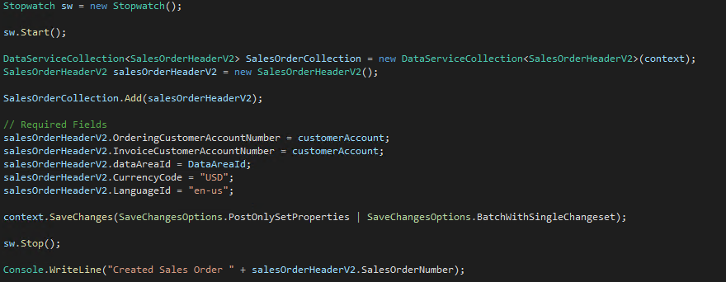
“Minimum”

Slide 48
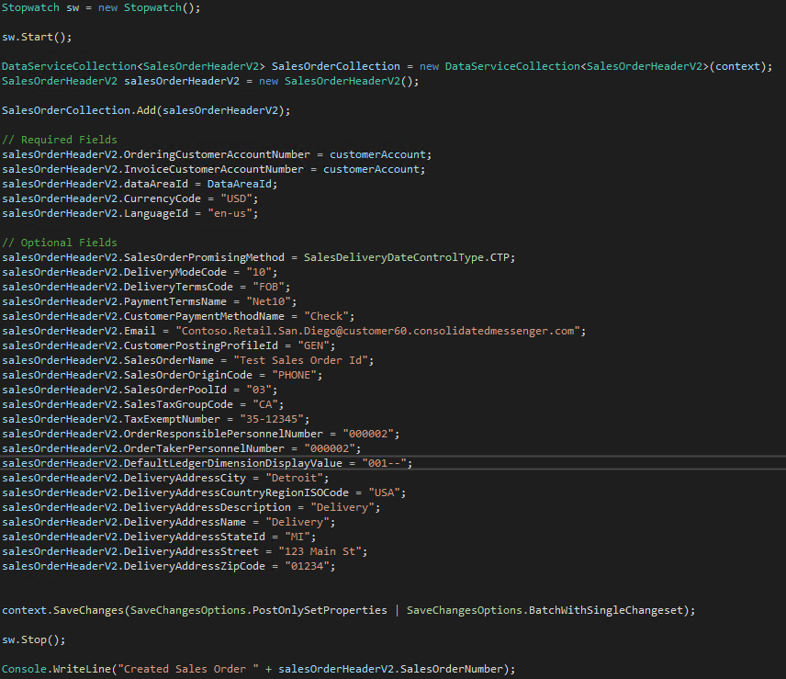
“Maximum”

Slide 49
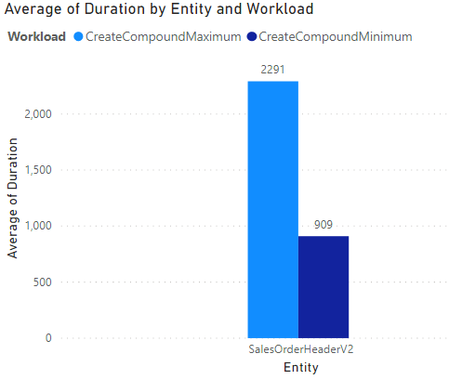
UAT / T2
Notes:
UAT

Slide 50

Insert Performance – “Simple” Entities
Simple entities
Have only 1 or 2 tables (minimum of what is required for the specific requirement)
Can handle very little code, only what is required to fill the need
Again, Performance scales to amount of data being persisted.

Slide 51
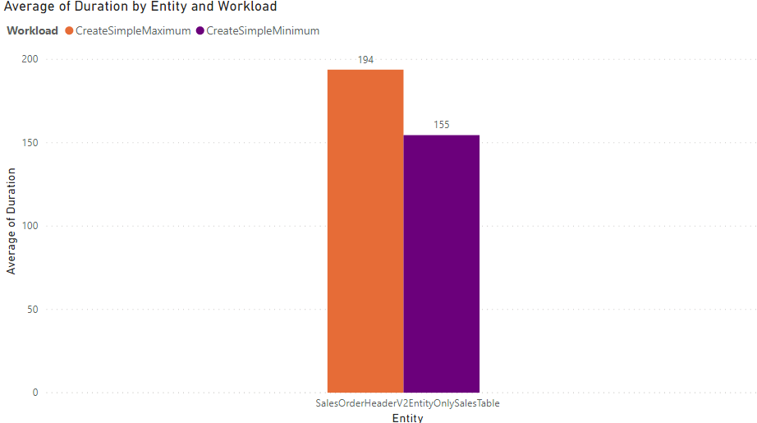

Slide 52
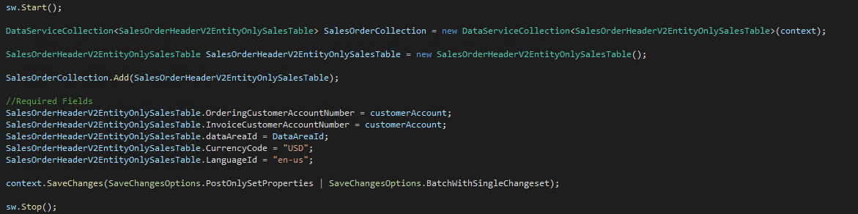
“Minimum” insert with simple entity

Slide 53
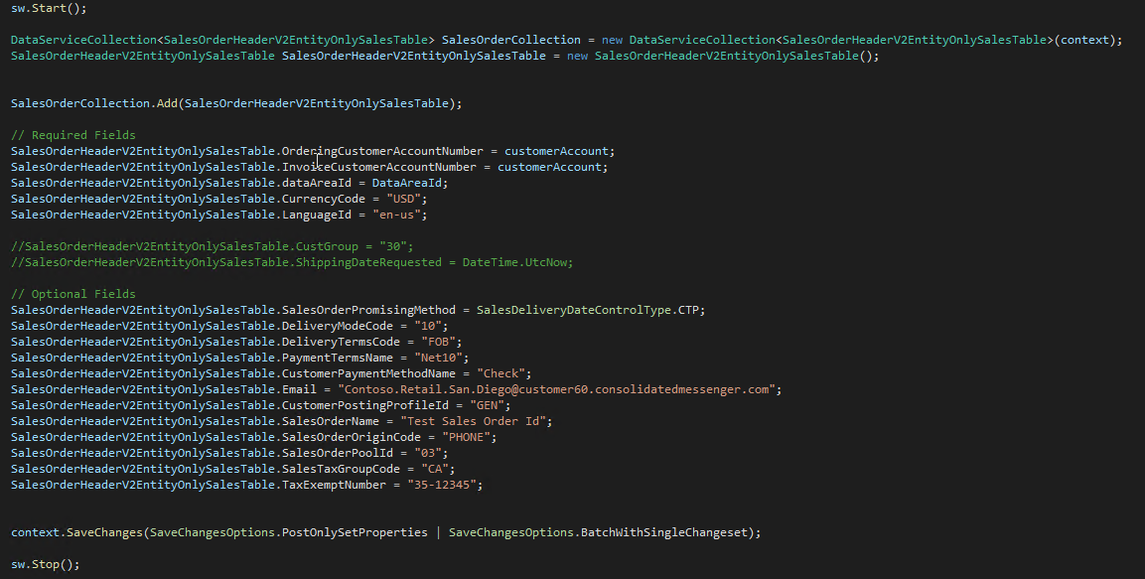
“Maximum” insert with simple entity
Notes:
Entity in an entity encapsulated functionality and concepts well
But slow, MSFT support not a fan of this in customizations

Slide 55

Update Performance
Same as insert performance
Updating fewer fields is faster than updating lots of fields
Business logic in classes/tables will always execute
“Simplicity” doesn’t quite scale as well

Slide 56
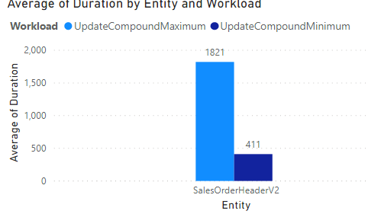
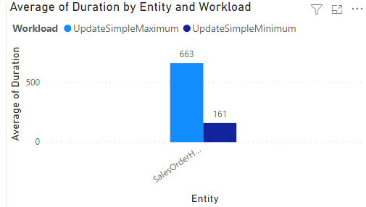
Compound
Simple
Notes:
Minimum is updating 1 text field with no validation
Maximum is updating 5 text fields with no validation

Slide 57
Notes:
Minimum is updating 1 text field with no validation
Maximum is updating 5 text fields with no validation

Slide 58
Notes:
Minimum is updating 1 text field with no validation
Maximum is updating 5 text fields with no validation

Slide 59
Compound
Simple
Notes:
Minimum is updating 1 text field with no validation
Maximum is updating 5 text fields with no validation

Slide 60

Delete Performance
Like insert performance
Unique Case
Only need to know the key to delete it
Scope on primary key
Then delete
Is it faster?
Can I Switch entities?
“simple” is faster than compound
“single” is the fastest

Slide 61
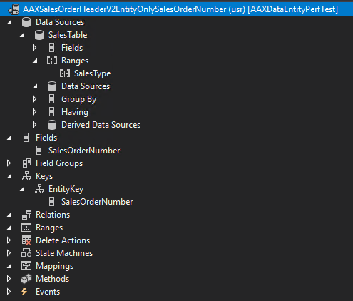

Slide 62
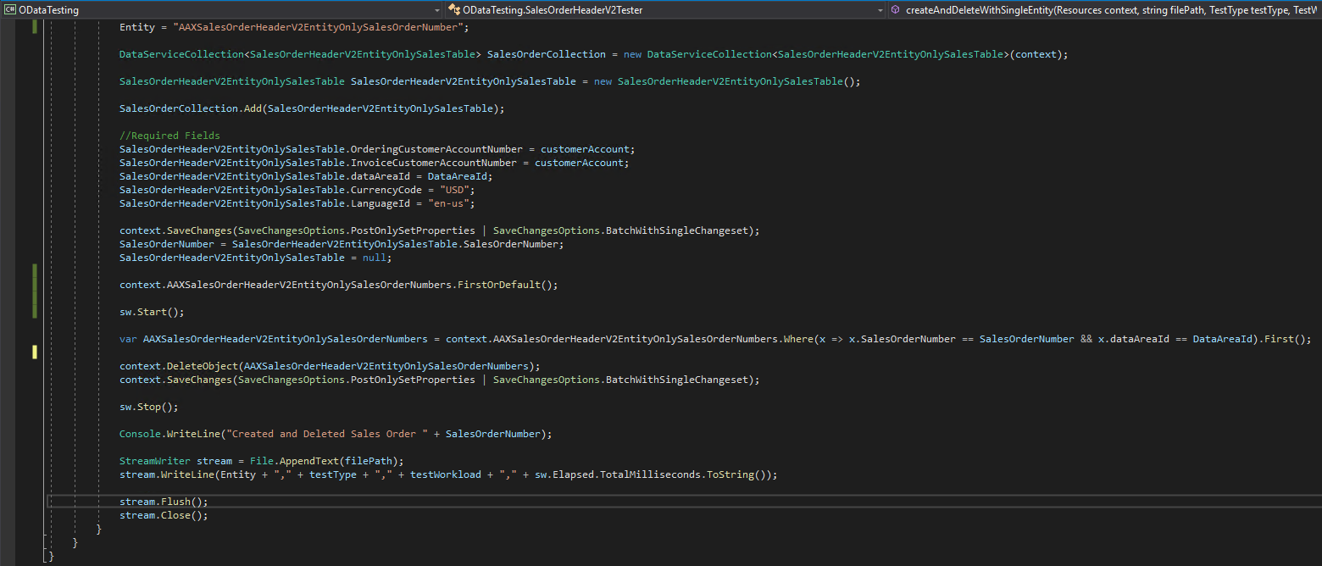

Slide 63
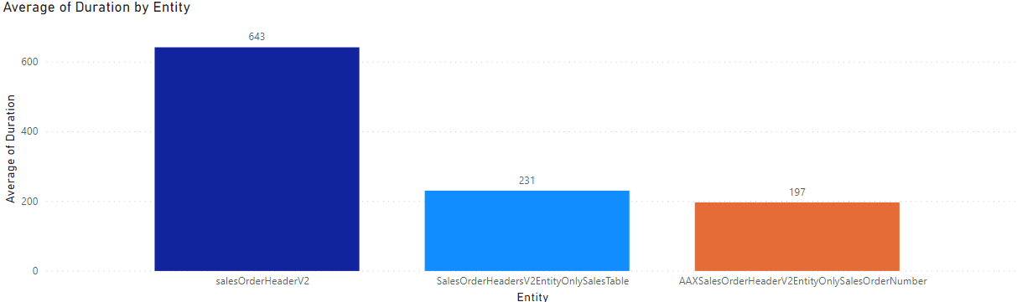
Delete Performance By Entity Type

Slide 64
Recap
Read Workloads
Fewer columns is better
Fewer joins is better
ReadOnly attribute is for functionality
Avoid sub-selects
Use SELECT() to reduce network lag for sets
Filter based on indexes
Limit use of ORDERBY(); sort after you get data
Use ORDERBY() on an index when used
Use EXPAND() when it makes sense
Don’t Multi-thread OData calls
Insert and Update
Fewer columns is better
Fewer joins is better
Fewer fields specified in operation is better
Create “Simple” entities, if applicable
Delete
Use “Single” entity for best performance
Build
Measure
Learn

Slide 65
References
http://www.atomicax.com/content/odata-experiment-deep-dive-odata-and-how-use-it
https://github.com/NathanClouseAX/AAXDataEntityPerfTest
https://github.com/NathanClouseAX/AAXDataEntities
https://github.com/users/NathanClouseAX/projects/2

Slide 66
Questions?

Slide 67
Dynamics 365: Let’s talk Upgrade Rollout Approach (AX 2012 Upgrade Series: Part 6) – Tuesday @ 2:00
Dynamics 365 F&O Licensing, Upgrades, Costs and More (Part 2) – Tuesday @ 3:00
Retail and Warehousing: The Biggest Areas for Change in Dynamics 365 F&O (AX 2012 Upgrade Series: Part 3) – Wednesday @ 9:30
AX Sucks. Let’s talk Upgrades (AX 2012 Upgrade Series: Part 1)– Wednesday @ 10:30
An AX2012 Upgrade Journey - Wednesday @ 11:30
Dynamics 365 F&O Business Events From End to Start to End – Wednesday @ 1:40
Dynamics 365 F&O Upgrade Tech Talk: Code, Customizations, Extension and Power Platform (AX 2012 Upgrade Series: Part 5) – Thursday @ 10:00
How To Get The Most Out of Your Upgrade (AX 2012 Upgrade Series: Part 2) – Thursday @ 1:10

Slide 68
My Other Presentations
F&O Integration Roundup - Thursday @ 11:00
X++ Development Tips and Tricks plus D365FO.Tools! – Thursday @ 2:10

Slide 69
Give Away!

Slide 70

Please visit our booth
enVista booth #700
Meet with our experts
Learn about industry-leading practices
Get the most from your Microsoft investments
Register to win a YETI™ cooler
enVista
Booth
Hall C Entry

Slide 71

Survey Code

